Slide 1


John Buchanan
Ops Manager, East Renfrewshire Council
Switch forum
11th December 2015
Scottish Waste Industry Training Competency and Health & Safety

Slide 2
What is SWITCH?
Scottish Waste Industry Training, Competency, Health & Safety Forum
SWITCH is a multi-partnership forum made up of public, private and third sector organisations within the Resource Management Industry.
Its purpose is to provide leadership for the resource management sector by working collaboratively to raise standards within the sector regarding Health & Safety, training, learning & development and technical competence.
Scottish Waste Industry Training Competency and Health & Safety

Slide 3
Outline
Background to the SWITCH Forum
Why we think it’s important
Aims and objectives
How we see it working
Its structure
Governance/Membership
Communication & Engagement
Scottish Waste Industry Training Competency and Health & Safety

Slide 4

Action 13
Zero Waste Plan
“support continual improvement in Health & Safety and workplace skills in the resource management sector.”
Scottish Waste Industry Training Competency and Health & Safety

Slide 5
HSE Waste and recycling sector strategy 2012-15
H&S performance remains poor in relation to other industries:
Fatality rate 9 to 10 times the all-industry average,
Transport-related fatal injuries account for 2/3rds of the total
RIDDOR non-fatal injury rate ~4 times the all-industry average
80% of all reported injuries occur during collection and sorting activities
Potential health risks from emerging processes and activities
Risks to members of the public because of significant public interface
Scottish Waste Industry Training Competency and Health & Safety

Slide 6
Waste collection – Why most hazardous?
Peripatetic, undertaken on public roads with live traffic and in constantly changing conditions
Direct interface with the public - risks apply to them as well
Workers deal with a variety of materials / risks that are not within their employer’s direct control.
Direct management and supervision is more difficult than at fixed workplaces
Potentially compounded by a 'task and finish' working culture if this is not properly managed
Challenges may be affected by changes to working trends more waste separation/ increasingly frequent collections/ extended working hours
http://www.hse.gov.uk/aboutus/strategiesandplans/sector-strategies/waste-and-recycling.htm

Slide 7
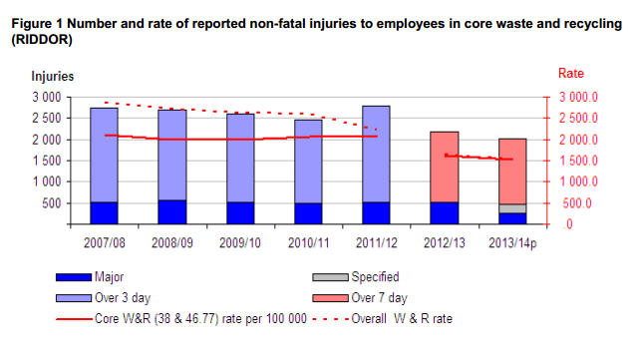
HSE Statistics 2014
Scottish Waste Industry Training Competency and Health & Safety

Slide 8
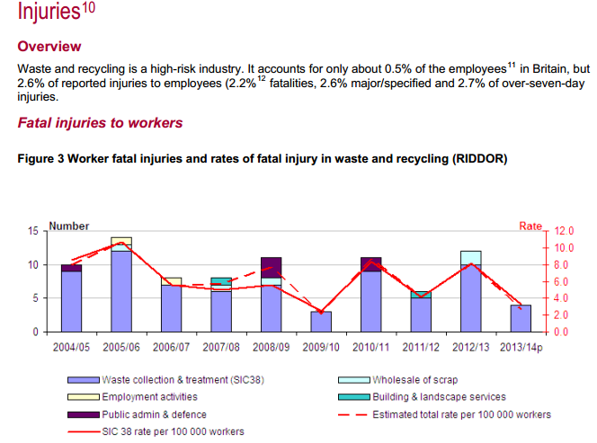
HSE Statistics 2014
Scottish Waste Industry Training Competency and Health & Safety

Slide 9
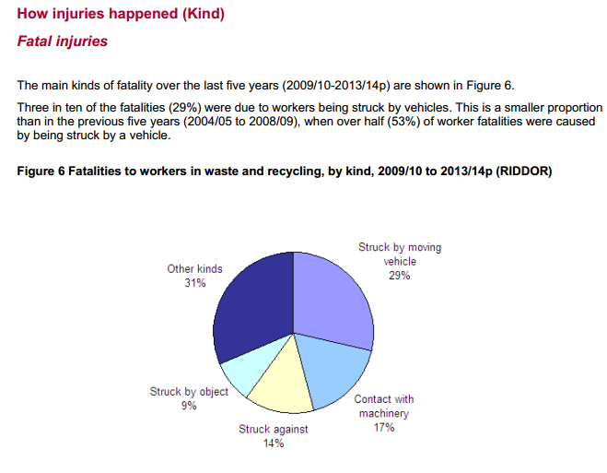
HSE Statistics 2014
Scottish Waste Industry Training Competency and Health & Safety

Slide 10
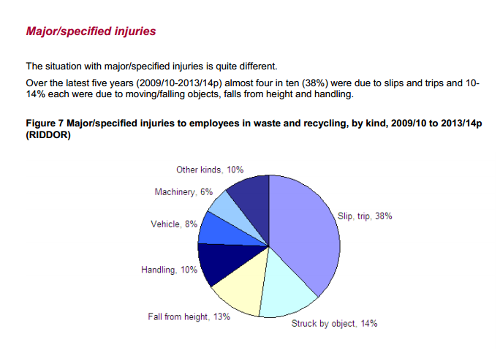
HSE Statistics 2014
Scottish Waste Industry Training Competency and Health & Safety

Slide 11
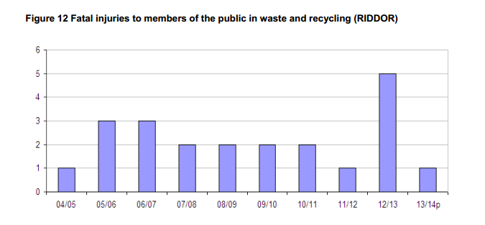
HSE Statistics
Scottish Waste Industry Training Competency and Health & Safety

Slide 12
SWITCH Strategic Objectives
Resource Management Industry
Is safe and healthy to work in
Actively supports education, training, learning and development
Increases workforce capacity and competence
Develops and shares good practice
Creates an industry that is attractive as a career choice
Creates clear career and learner pathways
Scottish Waste Industry Training Competency and Health & Safety

Slide 13
SWITCH approach is to collaboratively:
Identify emerging issues
Explore creative solutions
Share ideas
Promote good practice
Work to achieve high standards across all its working themes
Scottish Waste Industry Training Competency and Health & Safety

Slide 14
















Many public, private and third sector organisations are involved…..
SQA
Wm Tracey Group
RoSPA in Scotland
Keenans Recycling Ltd
HSE
Health and
Safety Executive
Viridor

Slide 15
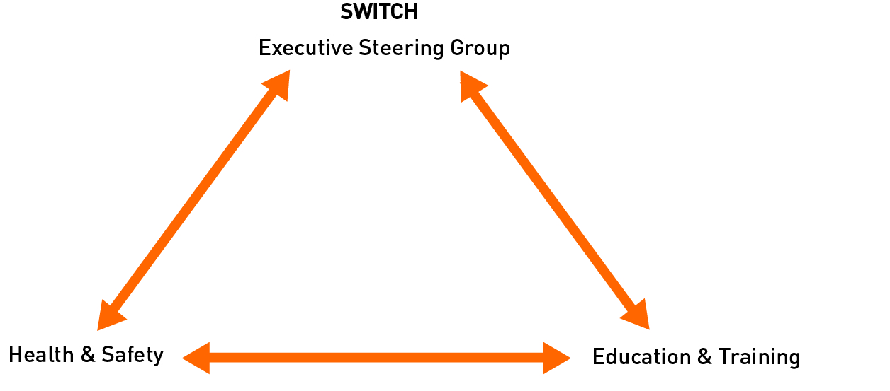
Structure
Scottish Waste Industry Training Competency and Health & Safety

Slide 16
WISH
Waste Industry Safety & Health (UK Forum)
A multi-party forum made up of organisations representing the waste and recycling industry. Established in 2004
Aims to identify, devise and promote activities to improve industry health and safety standards
Is committed to change by:
- establishing and sharing best practice
- improving the safety performance of the industry
- developing the competence of those who work in the industry
- improving perception of the waste industry as a safe place to work
http://www.hse.gov.uk/waste/wish.htm

Slide 17
SWITCH and WISH Relationship
SWITCH will be able to extend and broaden the reach of WISH in Scotland
Creation of open channels for engagement and communication between WISH and SWITCH to pursue common aims
4 WISH Working Groups have Scottish Representatives
  Strong leadership/Involve the workforce
  Build competence
  Creating healthier, safer workplaces
  Support SMEs
ZWS supports and adds value to work of SWITCH through its programmes (including grants, LA/Resource Industry support, training, events and voluntary commitments)
Scottish Waste Industry Training Competency and Health & Safety

Slide 18
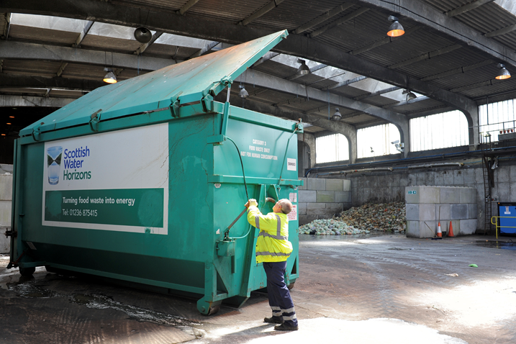
  Thank you for listening
  For further information:
  switch@zerowastescotland.org.uk
Scottish Waste Industry Training Competency and Health & Safety

